Slide 1
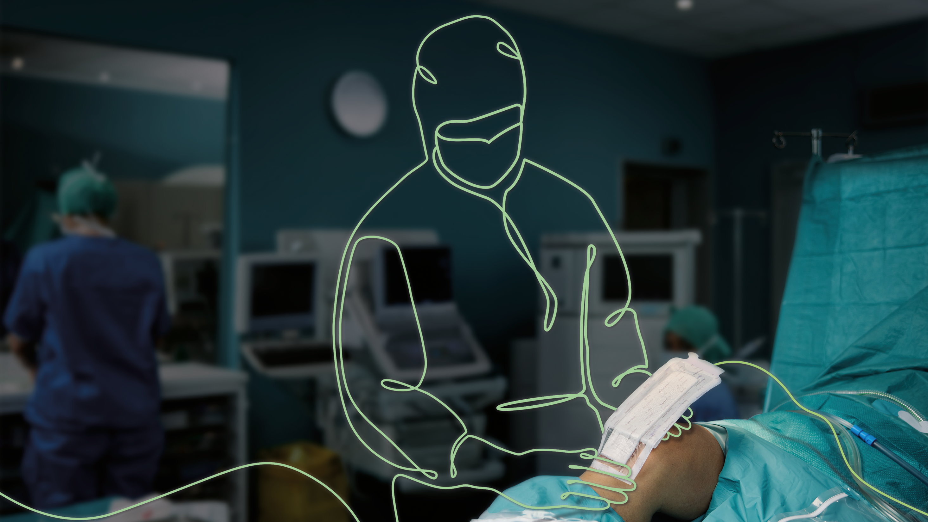
Mepilex®
Border Post-Op
The standard of care
every patient deserves
Extend Your Excellence

Slide 2

Surgical site complications undermine your outcomes – prevention is vital
6 10
11
>€20K
up to
out
of
extra
days
orthopaedic patients risk developing post-operative blisters¹
in hospital due to SSI²
additional cost per patient with an SSI²
Notes:
The consequences of surgical site complications (SSCs) and delayed healing can be devastating.

Slide 3
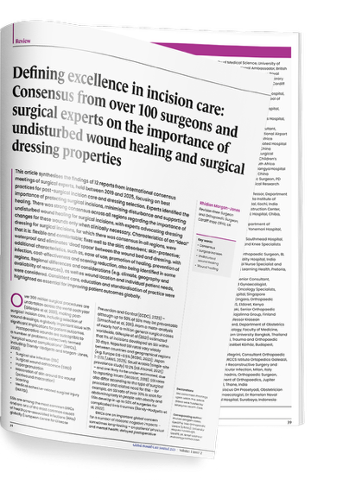
Surgeons’ consensus on incision care
100+
surgeons and surgical experts from across the world*
Morgaon-Jones R. Defining excellence in incision care: Consensus from over 100 surgeons and surgical experts on the importance of undisturbed wound healing and surgical dressing properties. Global Wound Care Journal, 2025.

Slide 4
The surgeons’ and experts’ consensus on dressing change protocol:
Leave the dressing in place for as long as possible to:
€
Minimise
Reduce
Optimise
contamination
Cost and time
healing
Morgaon-Jones R. Defining excellence in incision care: Consensus from over 100 surgeons and surgical experts on the importance of undisturbed wound healing and surgical dressing properties. Global Wound Care Journal, 2025.

Slide 5
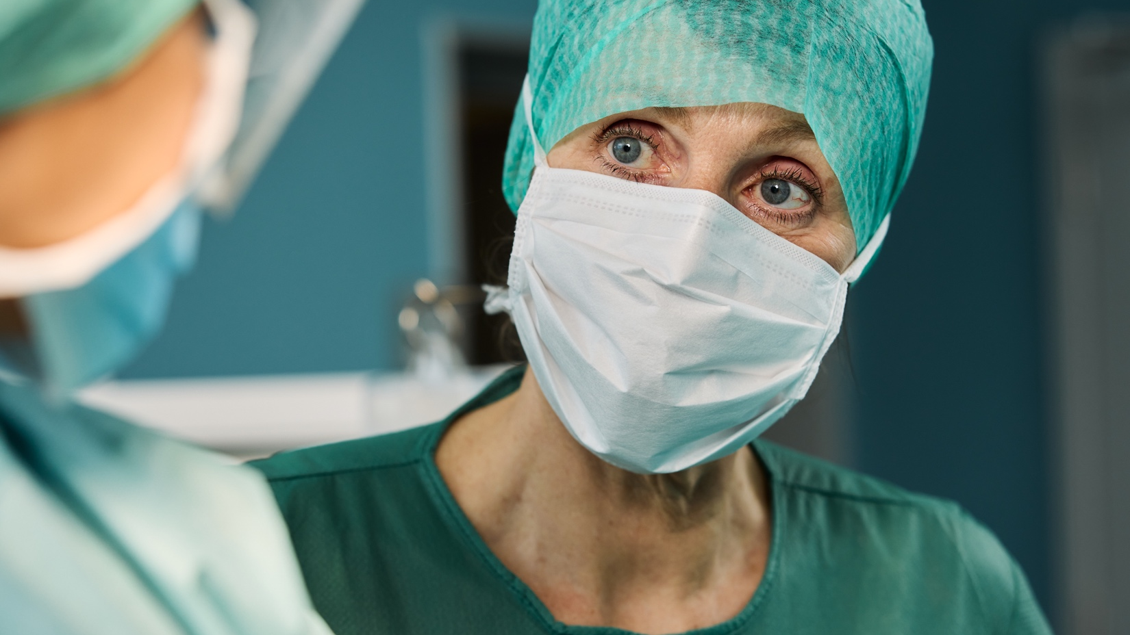
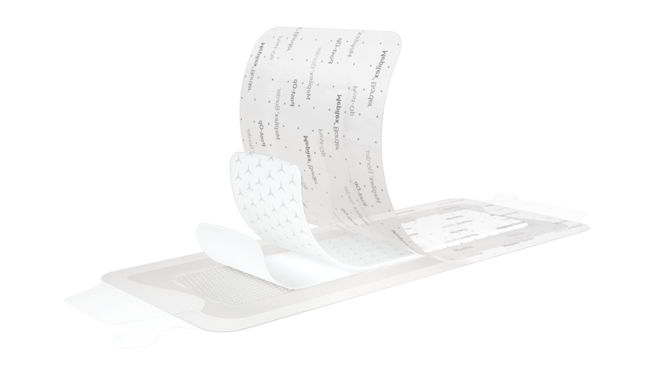
The surgeons’ consensus on dressing properties
Inspiration to
the design
The six important ones:
Be flexible
- not impede patient mobilisation
Stay on well
Absorb well
- to stay on longer
Protect the skin from damage
- e.g. blisters
Be shower proof
Eliminate dead space between the dressing and the wound
Notes:
Byt bild

Slide 6

Inspiration to the design
The surgeons’ consensus
on dressing properties
The six important ones:
Be flexible
- not impede patient mobilisation
Stay on well
Absorb well
- to stay on longer
Protect the skin from damage
- e.g. blisters
Be shower proof
Eliminate dead space between the dressing and the wound
Notes:
Gör texten I boxarna ljusare så att man kan läsa.

Slide 7
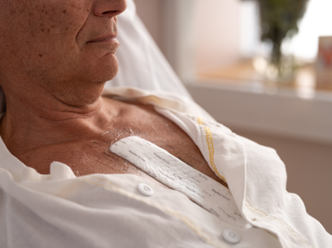
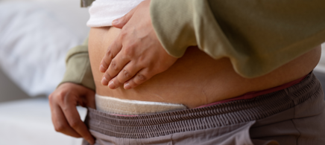
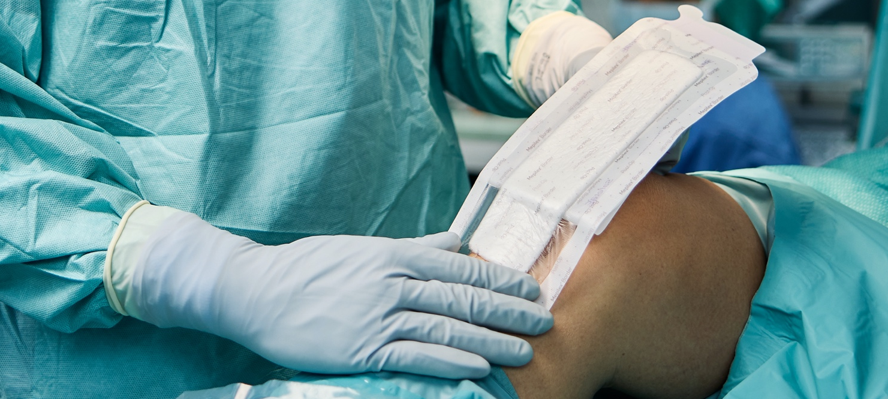
The one solution
A highly absorbent pad with Flex TechnologyTM
Water proof backing film
Safetac® wound contact layer
across the entire surface of the dressing
Notes:
Förklara vad safetac är *
*Safetac® wound contact layer across the…

Slide 8
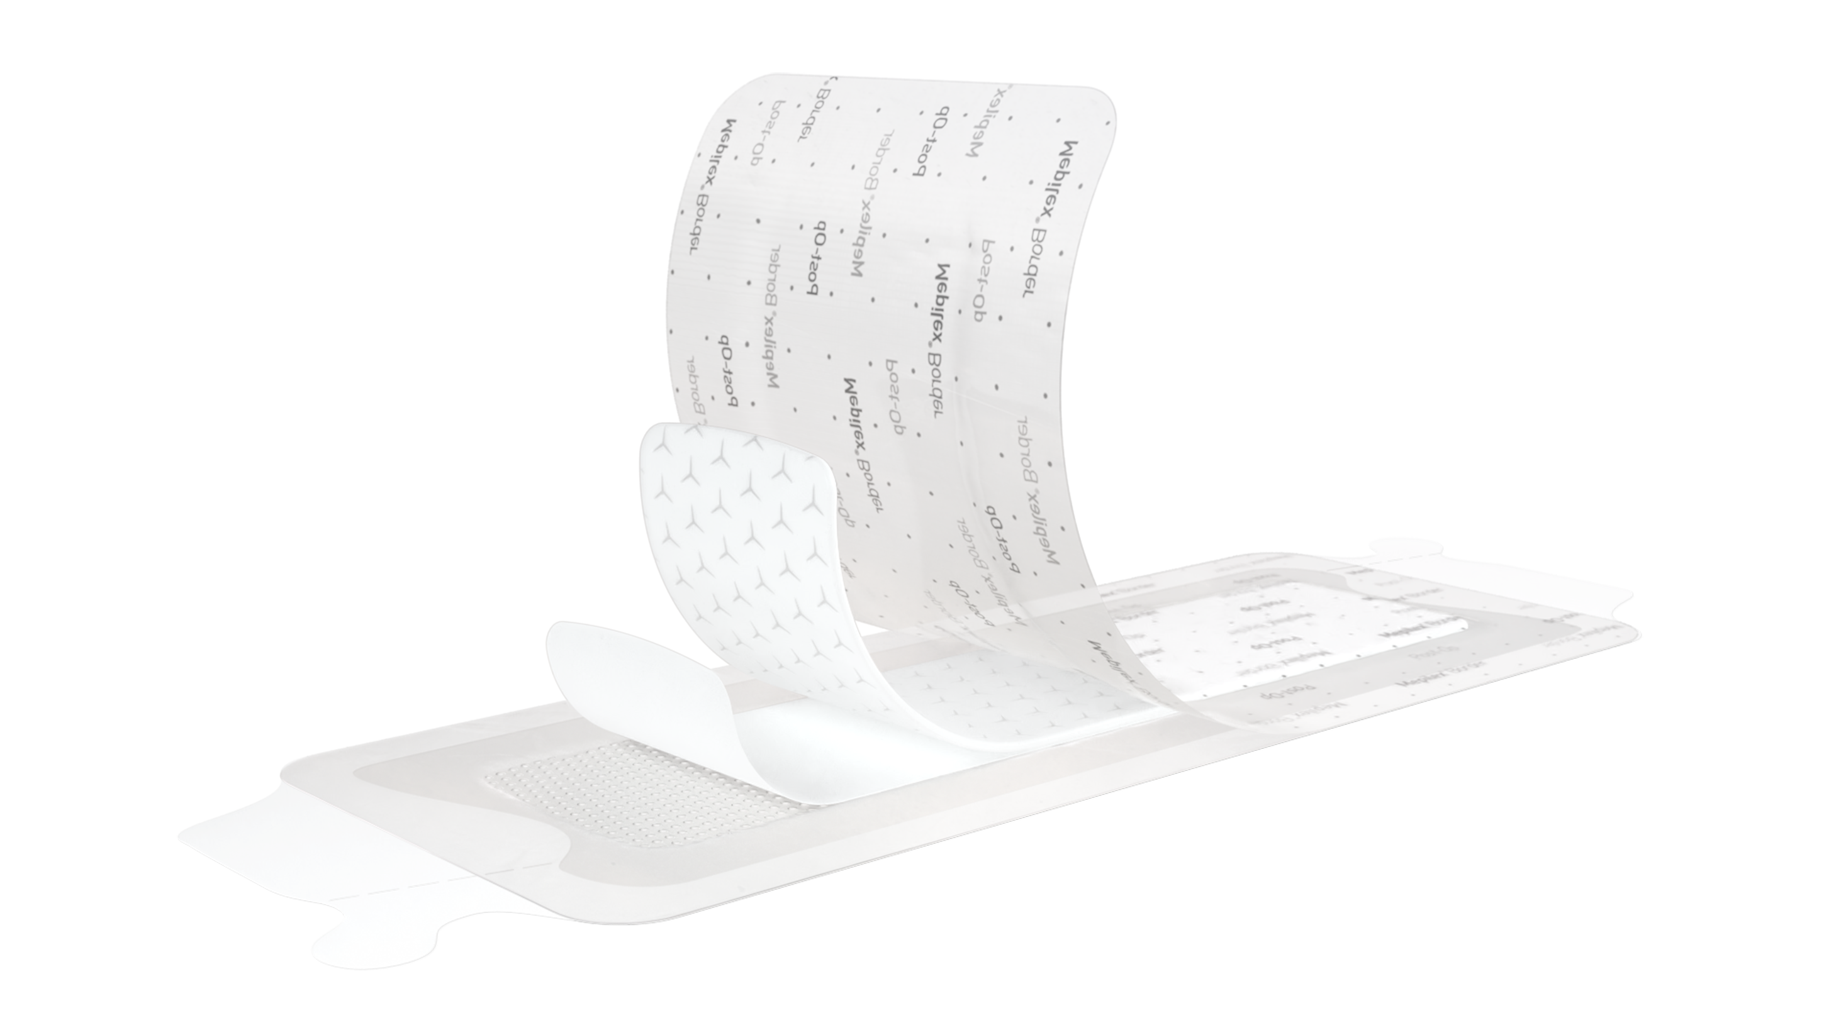

Fulfilling the requirements with evidence
1
Showerproof³, backing film barrier to microbes >25mm⁴
Up to 14 days’ wear time for better value and less waste than low-cost alternatives
Flexible, supporting patient mobilisation with Flex Technology™⁵⁻⁷
2
Absorbs well and retains fluid in the highly absorbent pad^{5,8}
3
Supporting frame, easier handling and application.
4
Stays on well – up to 14 days⁹
Protects skin with
Safetac® technology⁵⁻⁷
5
Eliminates dead space with adhesive across the
entire dressing
6
Safetac technology

Slide 9

Key pieces of evidence
2025
334 patients
2024
554 patients
2020
103 patients
2017
208 patients
2018
322 patients
Srivastava N. et al¹⁰
Randomised Clinical Trial,
Open orthopaedics
v Overschelde et al⁹
Retrospective study,
Open orthopaedics
Beele et al⁵
Randomised Clinical Trial,
Open orthopaedics
Bredow et al⁷
Randomised Clinical Trial,
Open orthopaedics
Peghetti¹⁰
Quality Improvement Project, Open orthopaedics
Significantly lower incidence of surgical site complications compared to Aquacel® Ag and Opsite®
Safe use of Mepilex Border Post-Op
for up to 14 days
High patient satisfaction – also during rehabilitation
No skin damage
Excellent ability to
absorb blood
71% of patients needed no dressing change the first week
No skin damage
High patient satisfaction
Lower total cost
Dramatic reduction
of wound complications
from 13% to 1.5%

Slide 10
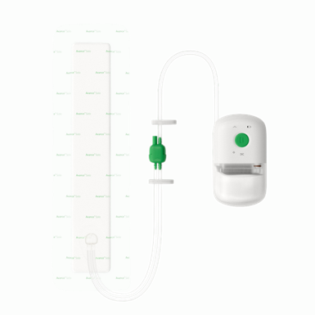
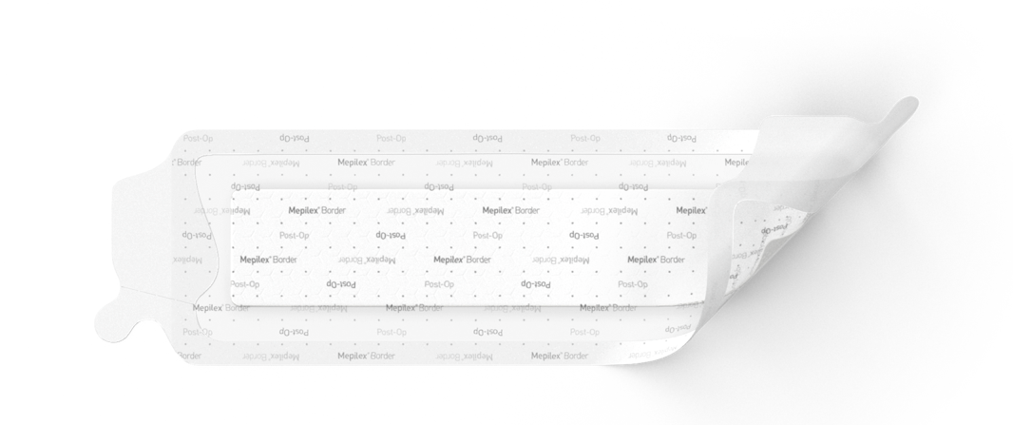
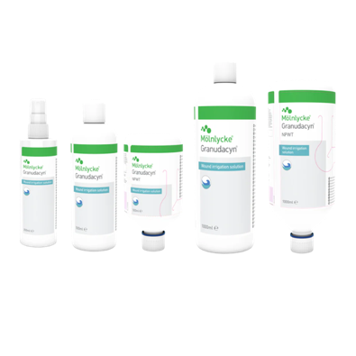
The Mölnlycke incision care solutions
Step-up approach:
Closed incision negative pressure therapy
High-risk patients need extra protection – no compromise.
Avance® Solo
Baseline:
Advanced surgical dressing
Every patient deserves an advanced
post-operative dressing – no exceptions.
Mepilex® Border Post-Op
Foundation:
Wound cleansing and irrigation
Setting up the body to heal.
Granudacyn®

Slide 11
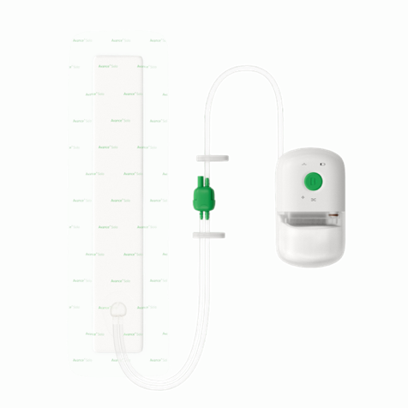

A paradigm shift:
applying the same scientific rigour to incision care as to surgery
Step-up approach:
Closed incision negative pressure therapy
High-risk patients need extra protection – no compromise.
Avance® Solo
Baseline:
Advanced surgical dressing
Every patient deserves an advanced
post-operative dressing – no exceptions.
Mepilex® Border Post-Op

Slide 12

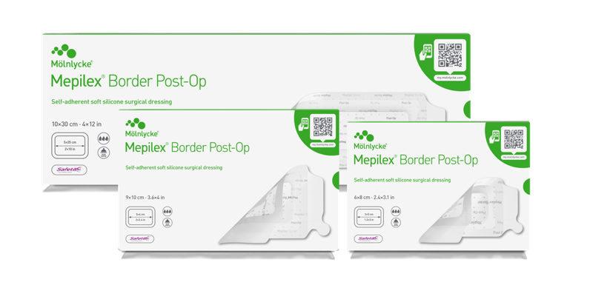
Mepilex Border Post-Op
A wide product assortment
Art.No:
496100
496150
496200
496300
496400
496450
496600
496650
Size (cm):
6x8
6x12
9x10
10x15
10x20
10x25
10x30
10x35
No patient deserves anything less
Notes:
Ta bort ® på Mepilex

Slide 13
References
Ousey K. et al. Risk factors, prevention and management of wound blistering: a scoping review. Global Wound Care Journal, 2025.
Hou Y. et al. Incidence and impact of surgical site infections on length of stay and cost of care for patients undergoing open procedures. Surgery Open Science, 2023.
Southern K et al. Compliance with the ISWCAP checklist in a THR ERAS pathway – A snapshot audit. Clinical Nutrition, 2023.
External test at Nelson Laboratories (viral penetration test), Study Report 1064846-S01
Beele H. et al. A prospective randomized controlled clinical investigation comparing two post-operative wound dressings used after elective hip and knee replacement; Mepilex® Border Post-Op versus Aquacel® Surgical. International Journal of Orthopaedic and Trauma Nursing, 2020.
Zarghooni, K. et al. Is the use of modern versus conventional wound dressings warranted after primary knee and hip arthroplasty? Acta Orthopaedica Belgica 2015.​
Bredow J. et al. Evaluation of Absorbent Versus Conventional Wound Dressing. A Randomized Controlled Study in Orthopaedic Surgery. Deutsche Arzteblatt International, 2018
Feili F. et al. A laboratory valuation of the fluid retention properties of post-operative absorbent dressings. Poster presentation at 5th Congress of the WUWHS, Florence, Italy, 2016.
Van Overschelde P, et al. Undisturbed wound healing: a single centre retrospective study investigating patient reported outcomes and clinical validity of extended dressing wear time for incisional healing following orthopaedic surgery, the ARCTIS study. Journal of Wound Care, 2024.
Srivastava N. et al. Comparative efficacy of advanced and traditional wound dressings in post-operative orthopaedic care for hip and knee surgeries: A randomized controlled trial. Journal of Clinical Orthopaedics and Trauma, 2025.
Peghetti A. Prevention of post-operative surgical site complications: A quality improvement project. Poster presentation at the EWMA congress, Krakow, 2018.

Slide 14
Thank you!
Mölnlycke Health Care AB, P.O. Box 6, Entreprenörsstråket 21, SE-431 21 Mölndal Sweden. Phone + 46 31 722 30 00. The Mölnlycke, Safetac, Mepilex, Granudacyn, Avance and Flex Technology trademarks, names and logos are registered globally to one or more of Mölnlycke Health Care Group of companies. ©2026Mölnlycke Health Care AB. All rights reserved. HQIM009417

